Slide 1

P#
<Computational Thinking for Design>
<2D Project – Parachute Design>
P#
Assignment
Context
Course
Date
2D Project – Parachute Design and Prototyping
Freshmore
Term 1
Computational
Design Thinking
2020
Student
<Description>
BEST PICTURE
Student Names
Student IDs
A short description of your project. Please use formal, as opposed to colloquial language here. Explain briefly what was the main objective of the project, the sources of inspiration, the approach developed, key technical challenges and solutions.
This is not about generic unorganized thoughts, experiences blogging, lessons learned etc. It is a concise summary of the project. Think of it as if you are writing the headlines for a news article.
<Overview>
Please stay within the boundaries of this text box and picture frames. We aim to compile an annual booklet of the “best of” projects. Uniformity is thus critical. The template is designed so it can be also printed in A4 size.
<Formatting Rules>
Regarding text, keep the monospace format for all body text. If you need to include sections use the style <Section> with bold face. Avoid text styles such as italics, underlines etc.
Instructor
ASD Instructor
ISTD Instructor

Slide 2
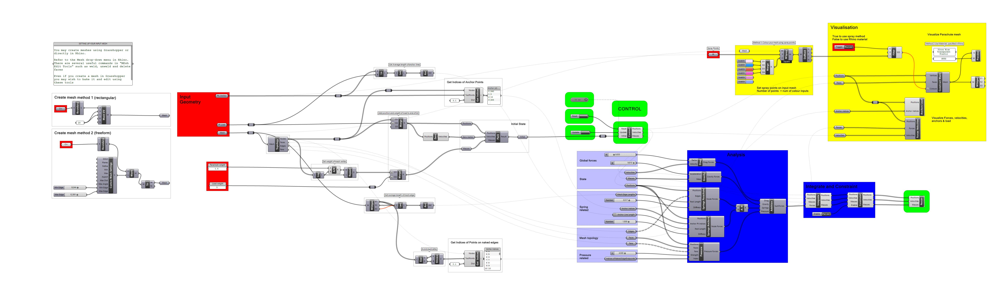
P#
<Computational Thinking for Design>
<2D Project – Parachute Design>
P#
<Grasshopper Program Overview>
Show overall program and highlight any parts which were modified or extended.
4)Visualisation
1)Setup Model
2)Sim Control
3)Physics Logic
Captions
01 Grasshopper definition explanation
01

Slide 3
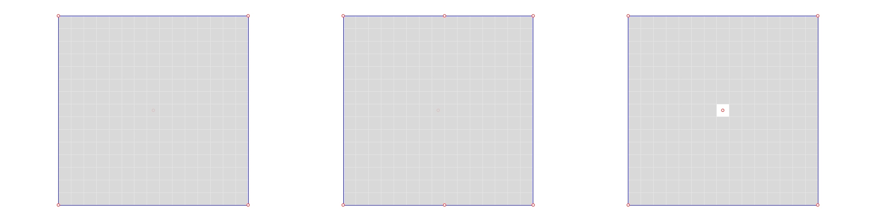
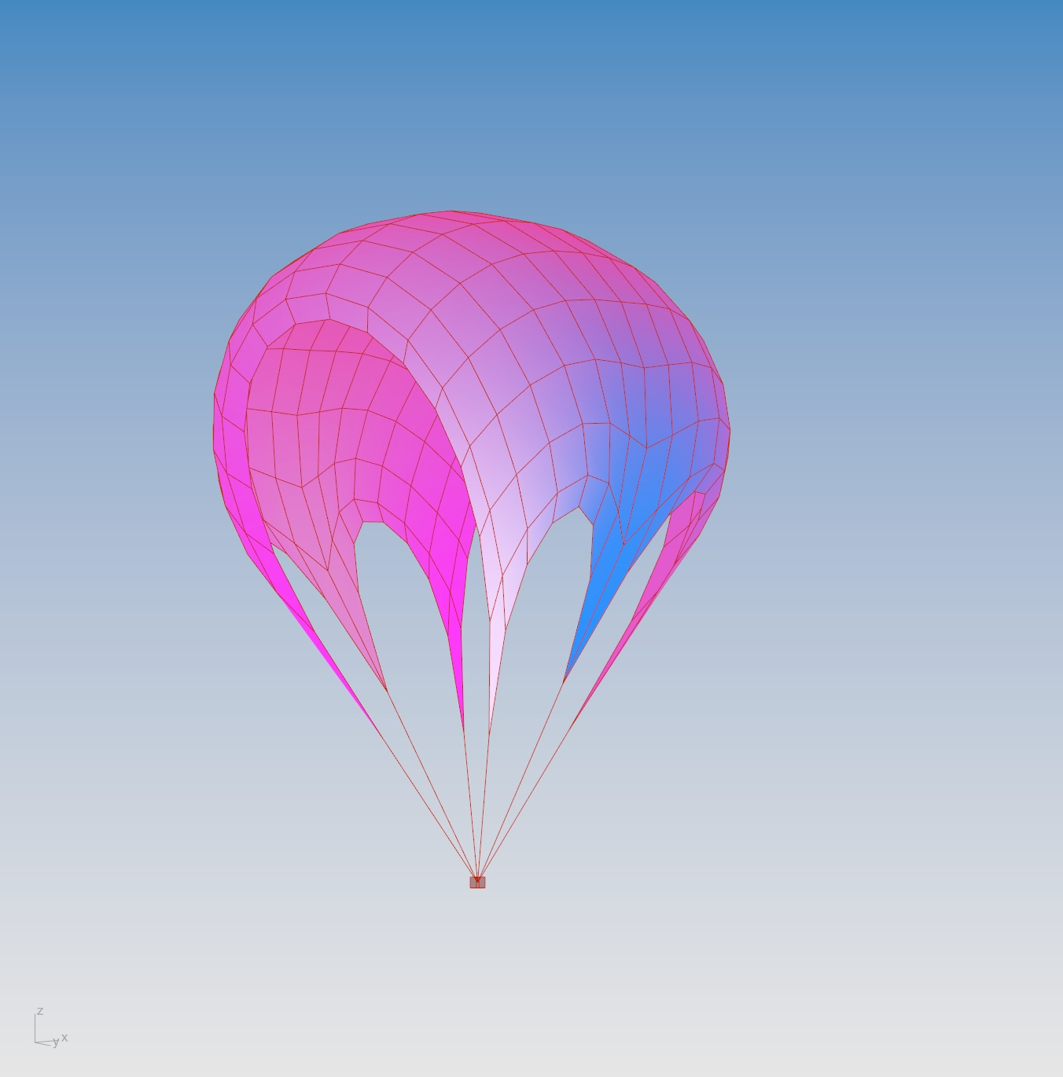
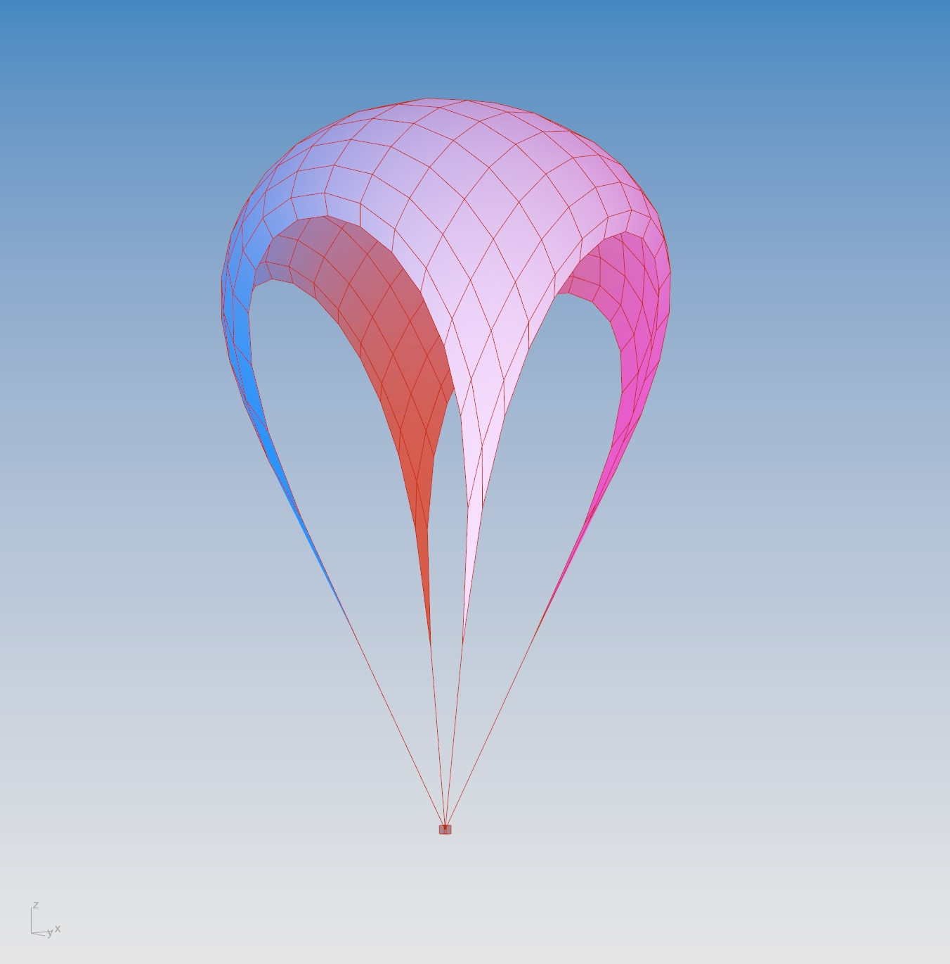
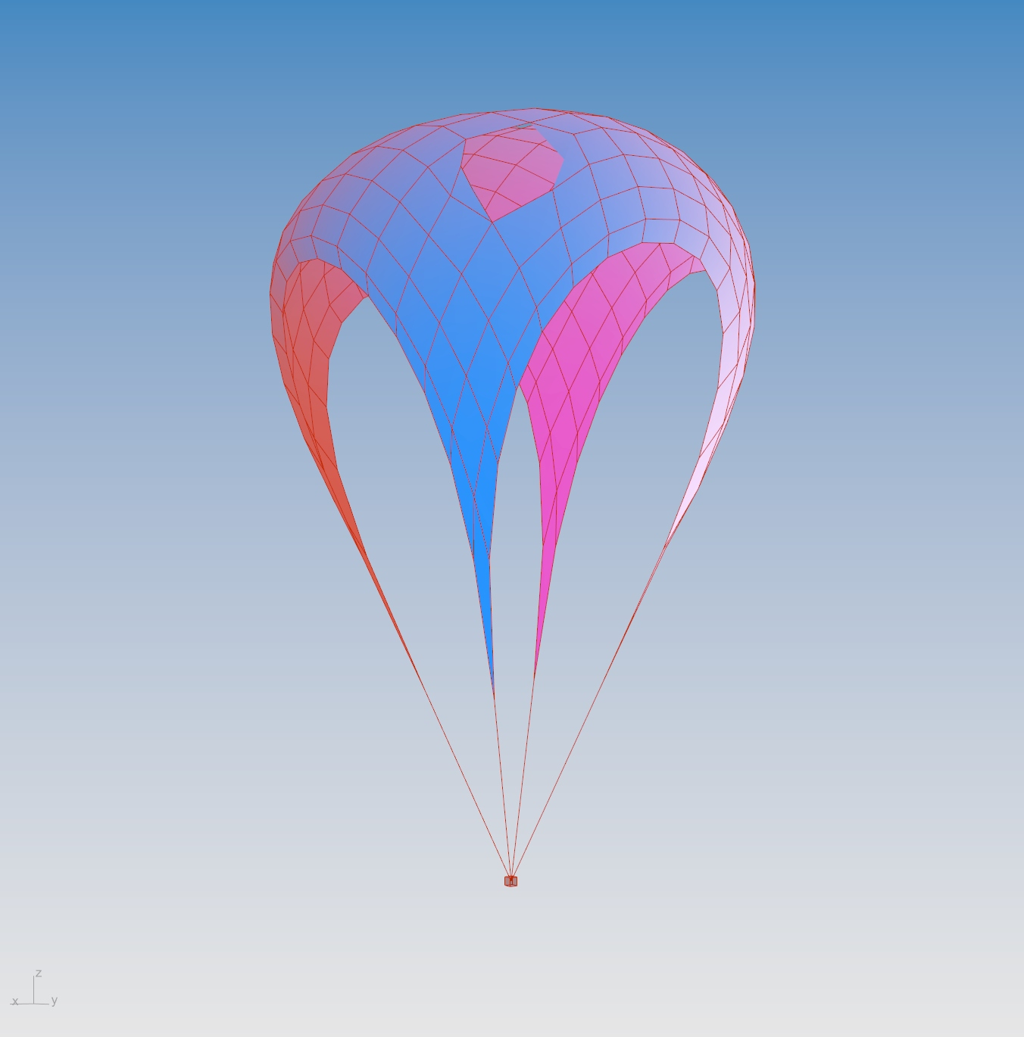
P#
<Computational Thinking for Design>
<2D Project – Parachute Design>
P#
<Variation Mapping>
Select at least 3 design variations and show both the initial setup and the form-found result. State the important parameters and quantitative metrics e.g. surface area of flat surface. Arrange variations from left to right in terms of desirability. Explain what contributes to desirability.
Captions
01 Initial state
02 Form found results
01
02

Slide 4
P#
<Computational Thinking for Design>
<2D Project – Parachute Design>
P#
VIDEO OF FORM-FINDING PROCESS
Captions
01 Animation
01

Slide 5
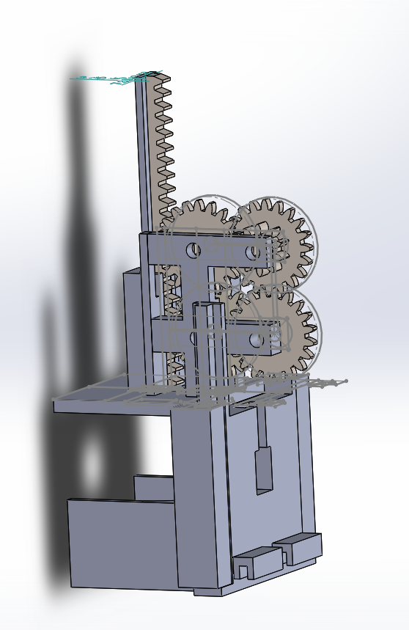
5
<Computational Thinking for Design>
<2D Project – Parachute Design>
5
PHOTOS/SKETCHES OF PROTOTYPE MAKING PROCESSPROCESS
Captions
01 Perspective
02 Top
03 Front
01
02
03

